Slide 1


Bioinformatic Discovery of Clinically Relevant Splicing Variants in Public Datasets
Rugare Maruzani, r.maruzani@liverpool.ac.uk, University of Liverpool
Supervisor: Dr Ali Awan, ali.awan@kcl.ac.uk, Genomics Innovation Unit, Guy’s Hospital

Slide 2
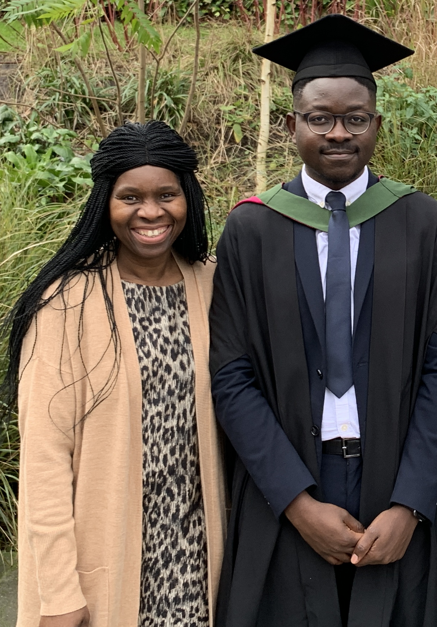
Introduction
University of Liverpool – MRC DiMeN DTP Computational Biology
My PhD focuses on developing tools to better detect low frequency ctDNA variants
University of Sheffield - MSc in Molecular Medicine
My interests are in leveraging computational tools to improve human health
This project was an opportunity to work on a project that could contribute to improving health using computational methods
Graduating from
Molecular Medicine
University of Sheffield, 2019

Slide 3

How Did I End Up Here?
MRC and DiMeN are supportive of PhD student internships
DiMeN has an extensive network of former and current students
Today, I will present the work I have been involved with over the last three months
Ideas and experimental approaches of the project
Outcomes
Dr Jack Paveley
Business Development Manager
APIS Assay Technologies Ltd.

Slide 4
Genetics Testing and Rare Diseases
Approximately 80% of ‘rare’ diseases have a genetic component
Genetic testing is routinely used to try and diagnosis rare diseases
Synonymous variants are often overlooked compared to variants with obvious consequences on protein production
Notes:
The The Challenge of Genetic Variants of Uncertain Clinical Significance - Wylie Burke
Most VUS are reclassified as benign
Keep this with more details on function/variants – why it’s difficult to connect variant and function, particularly with synonymous variants?
Rare disorders actually affect millions
Approximately 80% .... https://emea.illumina.com/areas-of-interest/genetic-disease/rare-disease-genomics.html
They shouldnt be overlooked!
Synonymous variants can disrupt transcription
Potential Questions

Slide 5
ClinVar is A Database of Variants and Their Relationship to Human Disease
Variants are classified into one of 5 categories based on clinical significance
Benign
Likely Benign
Variant of Uncertain Significance (VUS)
Likely Pathogenic
Pathogenic
Notes:
The The Challenge of Genetic Variants of Uncertain Clinical Significance - Wylie Burke
Most VUS are reclassified as benign
Keep this with more details on function/variants – why it’s difficult to connect variant and function, particularly with synonymous variants?
Rare disorders actually affect millions
Approximately 80% .... https://emea.illumina.com/areas-of-interest/genetic-disease/rare-disease-genomics.html
They shouldnt be overlooked!
Synonymous variants can disrupt transcription

Slide 6
Evidence Sources for Clinical Significance Classification
Notes:
Potential Questions
de novo data: Variants of uncertain significance (VUS) are those with no/conflicting evidence for pathogenicity
What are functional studies? Wet lab work that involves things like knockout, overexpression, animal models work > what does the variant do??
What’s in other catagory? A variant observed in combination with another known pathogenic variant may provide evidence for benign classification (if disease is inherited as a dominant condition) or for pathogenicity (if disease is inherited as an autosomal recessive condition)

Slide 7
The Five ClinVar Variant Classifications
n = 2,179,119
Notes:
VUSs can make up a substantial number of variants in genetics testing panels, approximately 47% +
VUSs can be reclassified where new evidence becomes available – 15% get reclassified as Pathogenic

Slide 8
VUSs Cause Patient Distress
/recall
l
anxiety
Clift, K., Macklin, S., Halverson, C. et al. Patients’ views on variants of uncertain significance across indications. J Community Genet 11, 139–145 (2020). https://doi.org/10.1007/s12687-019-00434-7
Notes:
Summarise this figure
Expand!

Slide 9
Reclassifying VUSs May Improve Prospects for Rare Disease Diagnosis
Resolving VUSs may hold information that can help diagnose rare diseases
VUSs are more prevalent in non-European ancestry individuals, with consequences for health inequality
Notes:
They dont contribute to clinical decision-making
Why are VUSs more prevelant in non-Europeans
A VUS result is also more likely to occur for patients who are not of European ancestry (9, 11–13) — a consequence of the limited population diversity in genomic data sets (14).

Slide 10
Project Aim
Develop a computational pipeline to characterise the effects that VUSs have on transcript splicing isoforms and expression levels

Slide 11
Overview of Research Questions
Which VUSs (if any) affect expression?
Which VUSs (if any) affect splicing
DNA
DNA

Slide 12
The Sequence Read Archive
SRA is the largest (mostly) public repository of NGS data, upwards of 17 Petabytes of data – 1 Petabytes = 1 million Gb
The database contains both DNA and RNA sequencing data from mostly human and mouse
We are searching RNA sequencing data
Querying the SRA for samples with a particular sequence is a huge challenge due to the size of the database
Notes:
139,095 iPhones with 128 GB of storage space each to store 17 petabytes of data.

Slide 13
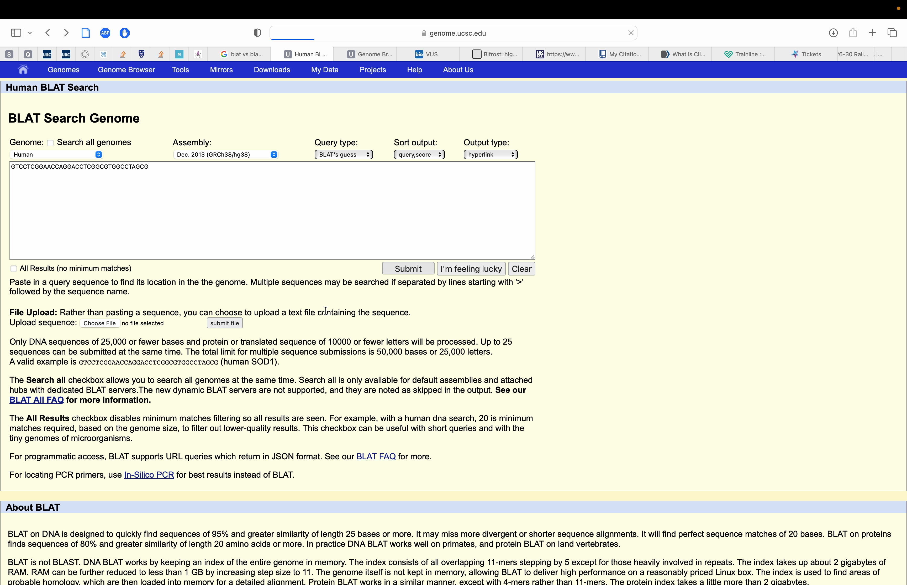

Slide 14
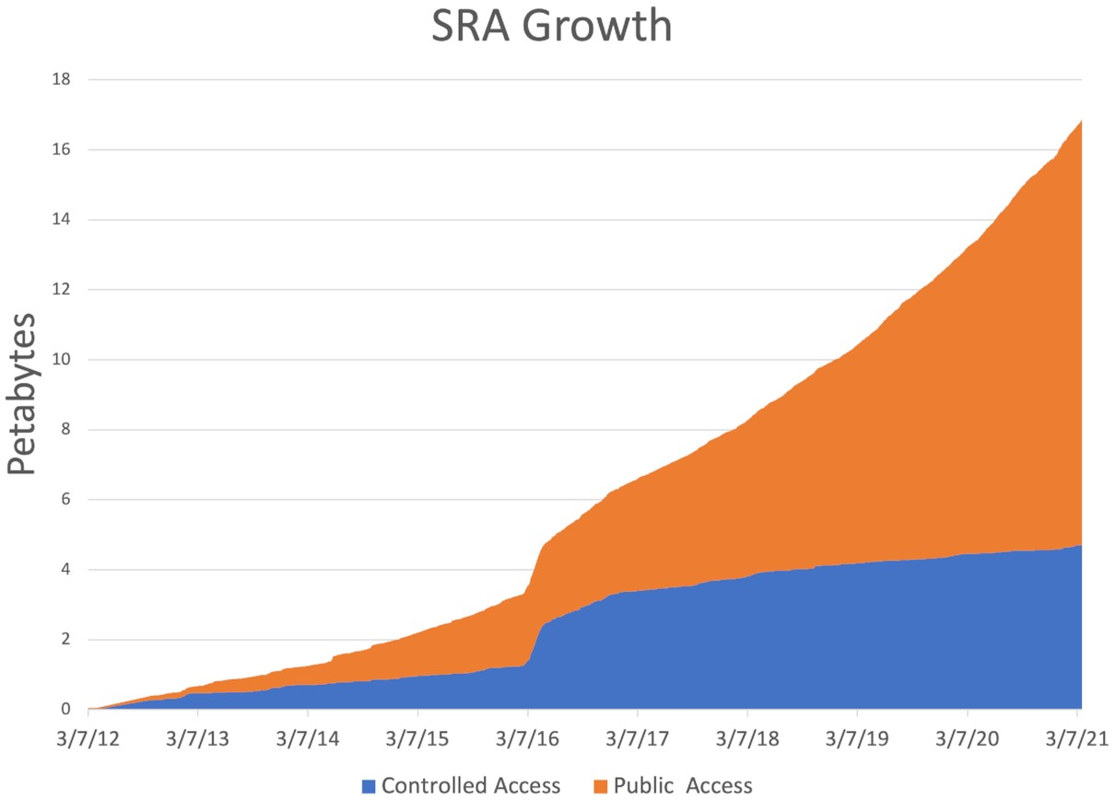
The SRA Explosive Growth
Kenneth Katz and others, The Sequence Read Archive: a decade more of explosive growth, Nucleic Acids Research, Volume 50, Issue D1, 7 January 2022, Pages D387–D390, https://doi.org/10.1093/nar/gkab1053

Slide 15



The Querying Problem
Which book does each sentence appear in? What page?
"Harry - yer a wizard."
"The road goes ever on and on."
"In a hole in the ground there lived a hobbit."
Index
...
“Harry - yer a wizard.”, Harry Potter and the Philosopher’s Stone, Page 92
....
....
“In a hole in the ground there lived a hobbit.”, The Hobbit, Page 8
....
"The road goes ever on and on.”, The Lord of The Rings, Page 34
...
Notes:
Now, let's introduce the concept of indexing to make the search more efficient.
You create an index where you list all the sentences in each book along with the corresponding book and page numbers. This index acts as a reference guide that allows you to quickly locate specific sentences.
With the indexing system in place, searching for a sentence becomes much easier. If someone provides you with the sentence they're looking for, you can refer to the index to find the book and page number where that sentence appears. Instead of going through every book, you can directly go to the book indicated in the index and flip to the specific page, saving significant time and effort.

Slide 16
Bifrost Enables Indexing of RNA-Seq Data
FASTQ files
FASTQ File Size = 1 Tb
Bifrost Index Size = 60 Gb
kmer = 3
Coloured de Bruijn graph
Notes:
Fix the top strand and get the explanation of Bifrost and debruijn graphs down
– flanking seq = 15, +1
- explain why k-size is 31, snps only
- the query sequence is not broken down into kmers at all

Slide 17
Querying Bifrost Index
Bifrost takes FASTA files as query input
Bifrost can query the index and return FASTQ files that contain the query sequence
Bifrost returns the original RNA-Seq sample containing the query sequence
Alternative Allele
Notes:
After this one NEXT SLIDE – flanking seq = 15, +1
explain why k-size is 31, snps only
Too small query sequency > more false positives

Slide 18
Pipeline Workflow
Variant ID | REF | ALT | Gene | Ref Q-Sequence | Alt Q-Sequence
1552 | A | G | TP53 | ATGTATCGGATTACG(A)ACTTCACGGAGACTA | ATGTATCGGATTACG(G)ACTTCACGGAGACTA
... | ... | ... | ... | ... | ...
ClinVar variants = 1233, VUS, synonymous, SNPs
Reference Q-Sequence
Alternate Q-Sequence
Variant ID | a.fastq | b.fastq | c.fastq | d.fastq
1552 | 1 | 0 | 0 | 1
... | ... | ... | ... | ...
... | ... | ... | ... | ...
Variant ID | a.fastq | b.fastq | c.fastq | d.fastq
1552 | 0 | 1 | 1 | 0
... | ... | ... | ... | ...
... | ... | ... | ... | ...
Notes:
Annotate on left fig slide 12

Slide 19
Pipeline Workflow
Variant ID: 1552
Gene: TP53
Reference Allele Samples
a.fastq
d.fastq
Alternative Allele Samples
b.fastq
c.fastq
TP53 Differential Expression?
Expressed Isoforms?
Notes:
Annotate on left fig slide 12

Slide 20
Quantifying Transcript Expression Trinity
Trinity assembles transcript sequences from RNA-Seq data
Gene only reads*
Notes:
for every 1,000,000 RNA molecules in the RNA-seq sample, x came from this gene/transcript
tpm normalises for the size of the gene
Kallisto does not require an alignment to quantify transcripts unlike other tools

Slide 21
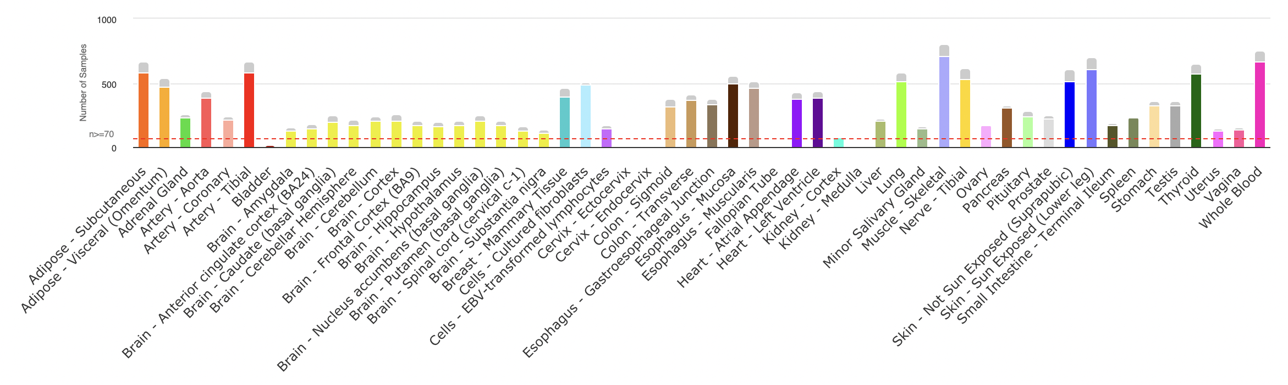
Stretch Goals: Tissue Specific Effects
GTEx Database holds tissue-specific gene expression and regulation data
https://gtexportal.org/home/tissueSummaryPage
Notes:
How to tell the

Slide 22
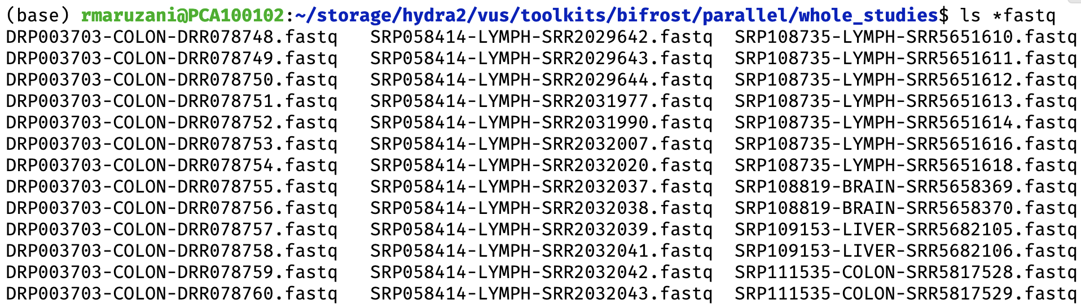
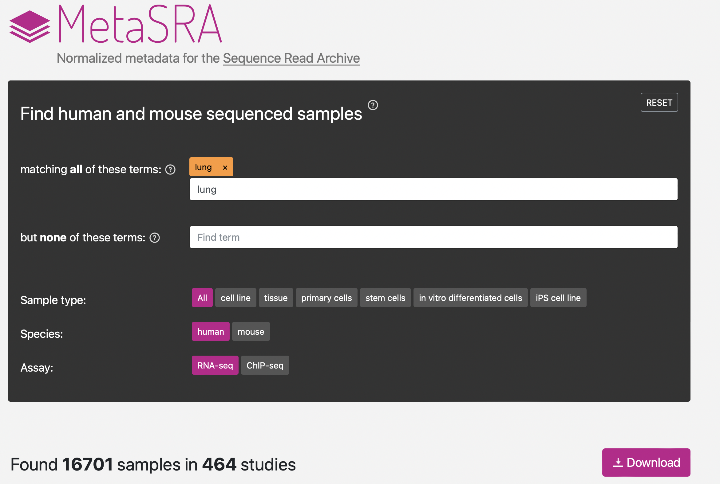
Stretch Goals: Tissue Specific Effects
MetaSRA provides a workaround to access tissue specific samples
24 MetaSRA tissues – Appx. 100 Gb per tissue
Notes:
Potential Questions:
How does metaSRA work?

Slide 23
Stretch Goals: Experimental Validation
If promising variants are discovered – perform experimental validation
Minigene assay

Slide 24
Houston, we have a problem...
Quality control rejects most variants
In samples where Bifrost finds a VUS:
1) Filter out all reads not mapping to the relevant gene > is the query sequence still still there?
2) For each VUS, we should have at least 5 samples supporting reference and alternate alleles
1233 synonymous VUS reduced to 15 we can assess for differences in expression and splice patterns
Notes:
Bulk download of SRA data requires some thought

Slide 25
This approach is not practical for reclassifying VUS
Requires a huge amount SRA data in local database to get a handful of variants to assess
Indexing NGS data is computationally expensive
With unlimited (to Bifrost) CPU and RAM
Building a Bifrost index with 1 Tb of FASTQ files = 3 days
Building a Bifrost index with 2 Tb of FASTQ files = Nearly 7 days!
Notes:
Bulk download of SRA data requires some thought

Slide 26
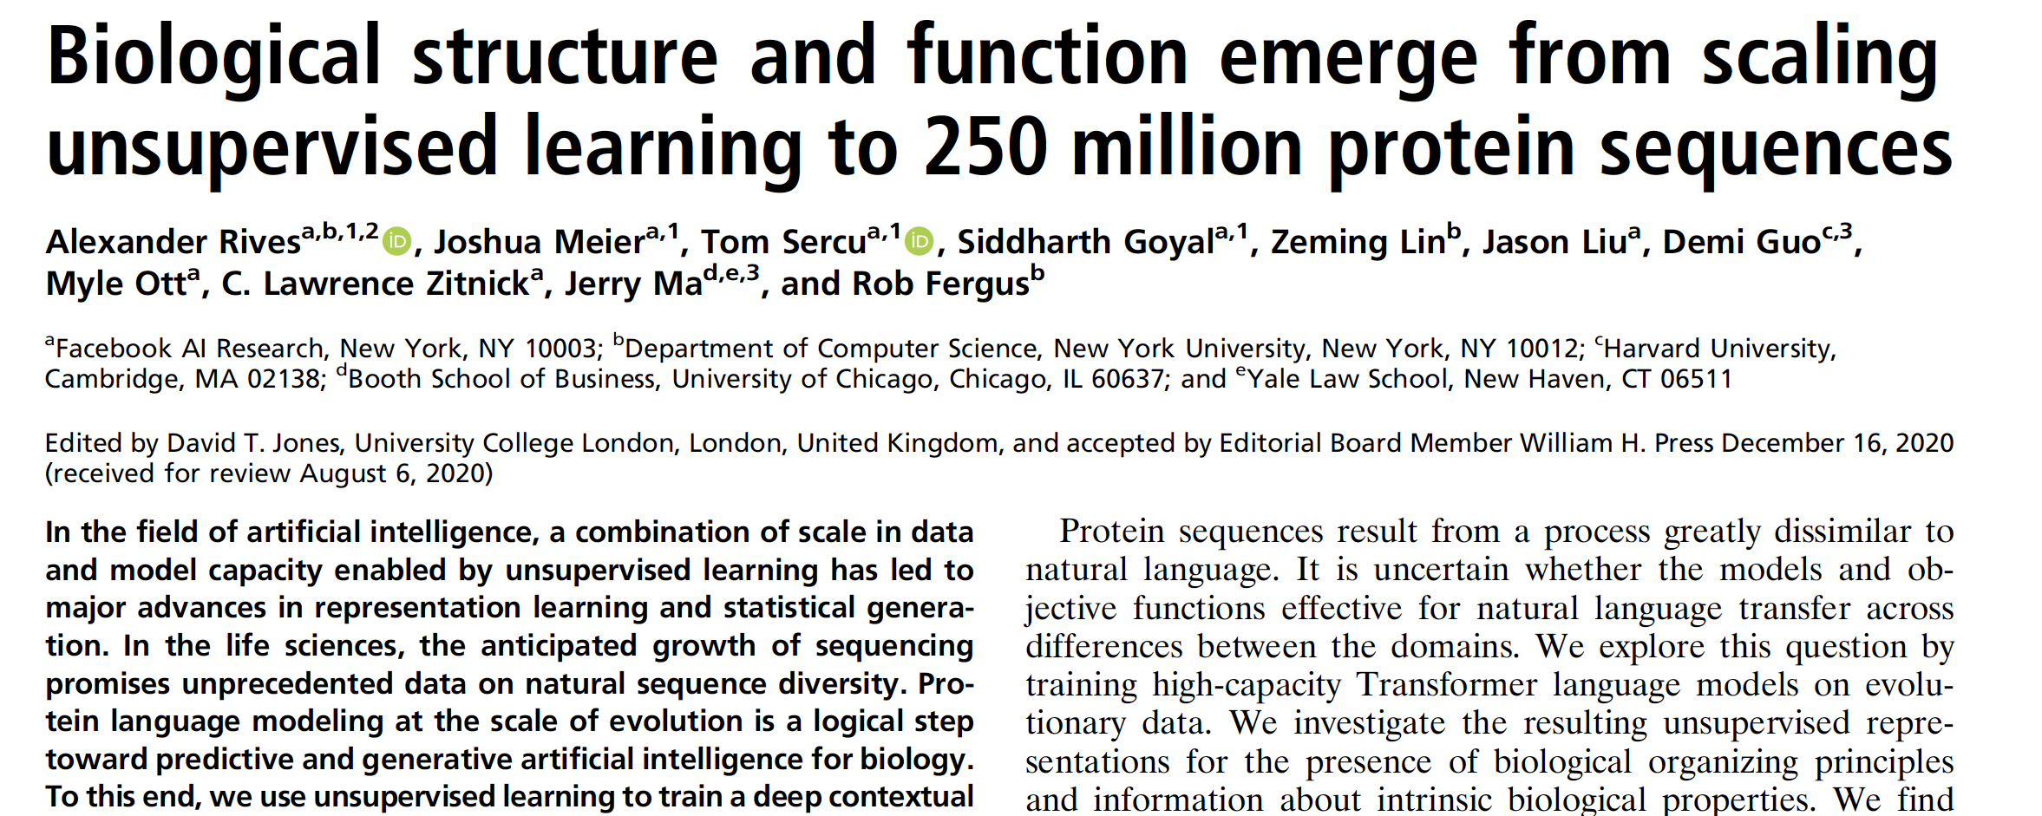
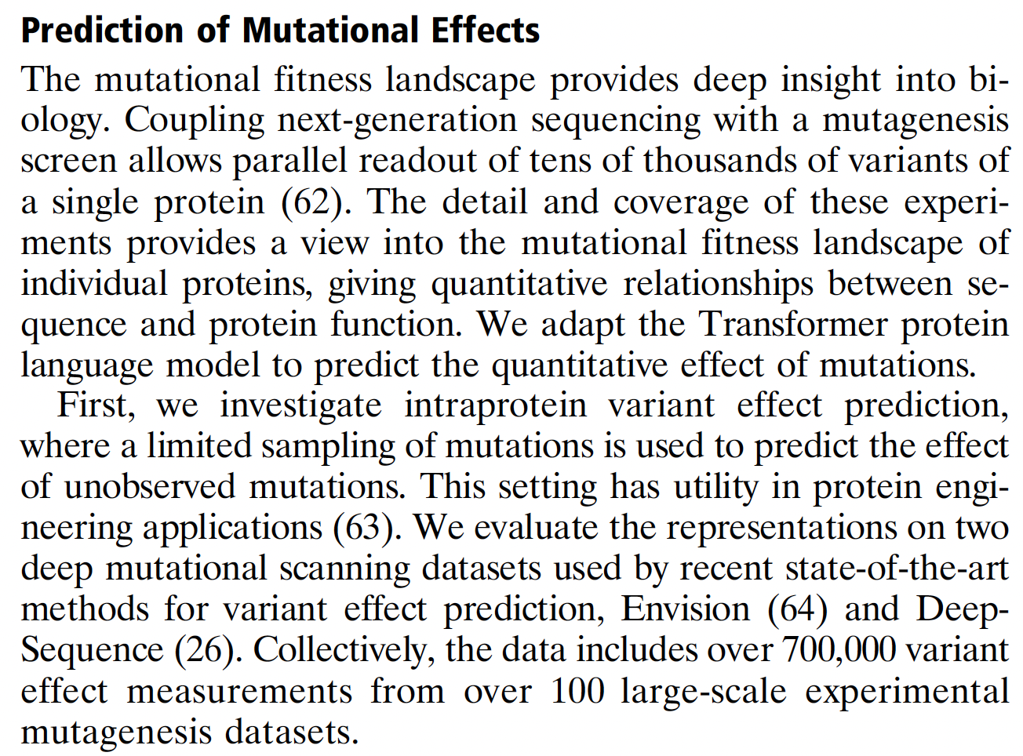
Notes:
Bulk download of SRA data requires some thought

Slide 27
Conclusions
Resolving VUSs can contribute to the diagnosis of rare diseases
We attempted to develope a pipeline that takes advantage of the SRA database to resolve VUSs
A challenge of working with the database is querying a given sequence in a large database
Ultimately, due to the large amounts of data and compute resources required – this approach is not practical for reclassifying VUS variants
Other methods are emerging for predicting mutation effects which could be used to reclassify VUSs

Slide 28
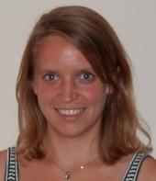

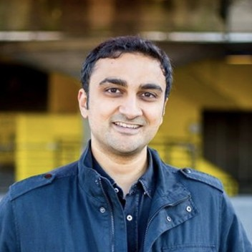
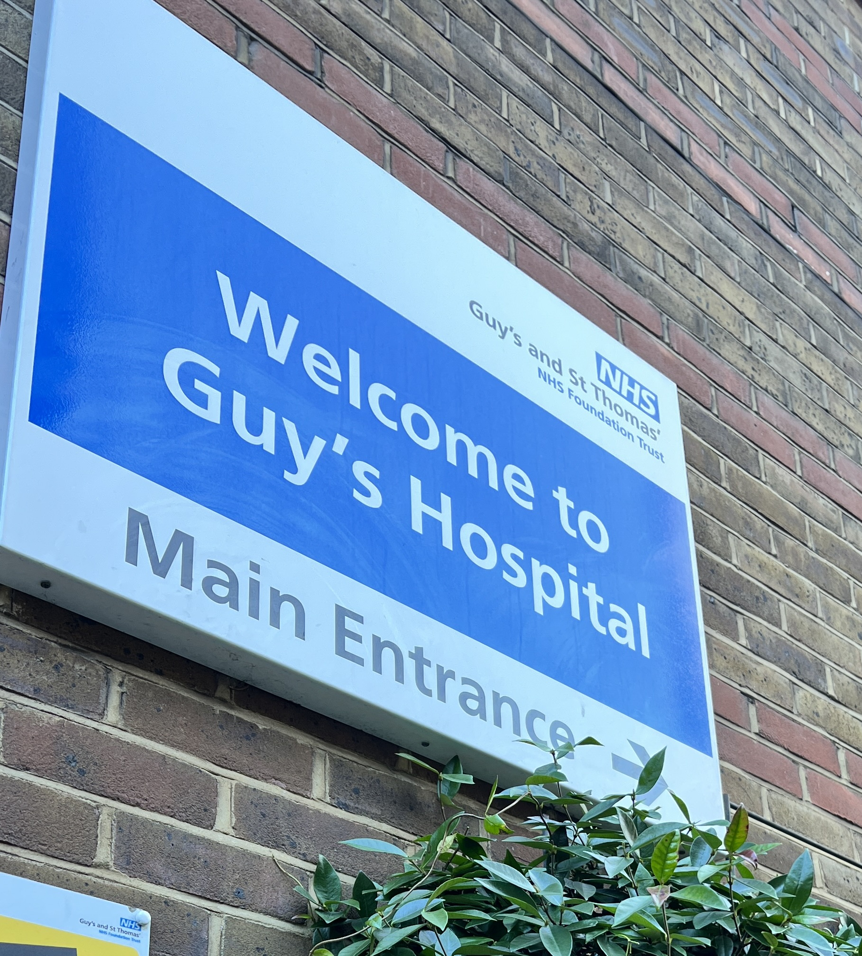
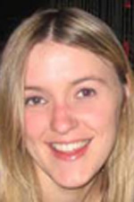

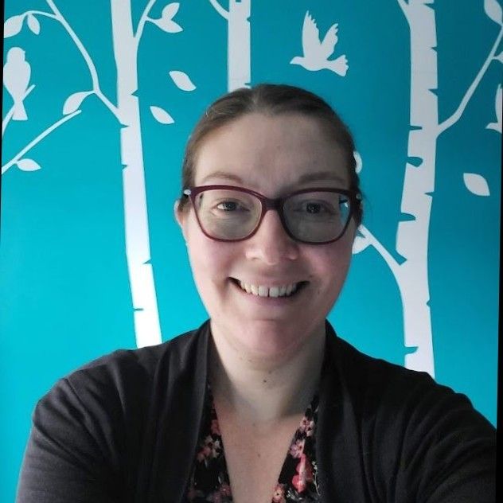
Thanks!
PhD Supervisory Team
and others
Genomics Innovation Unit
Dr Anna Fowler
3rd Floor
Dr Ali Awan
Prof Andrea Jorgensen
Dr Liam Brierley

